Slide 1
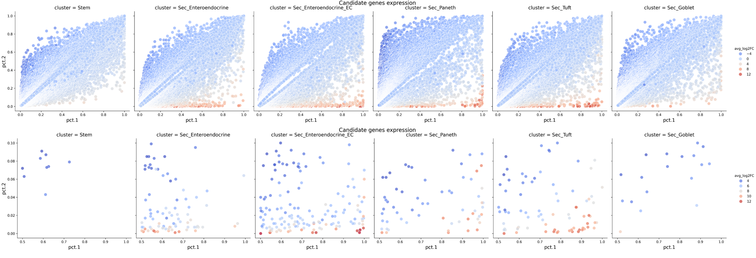

Slide 2
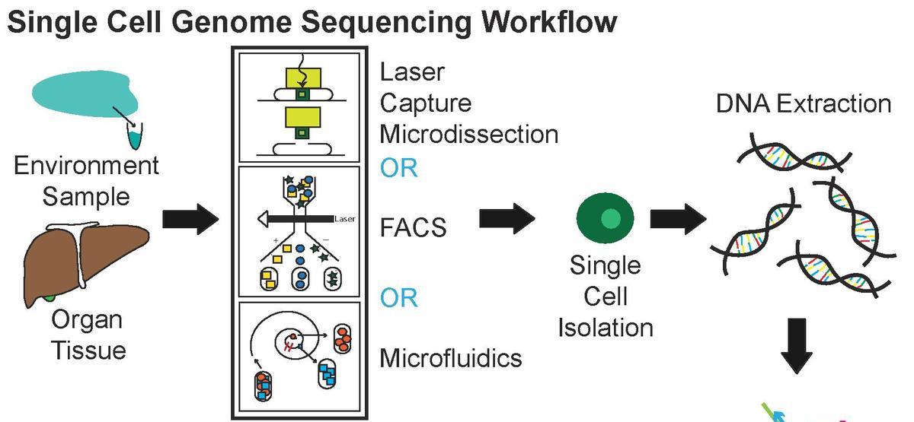
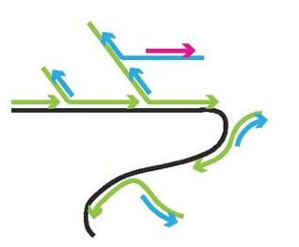
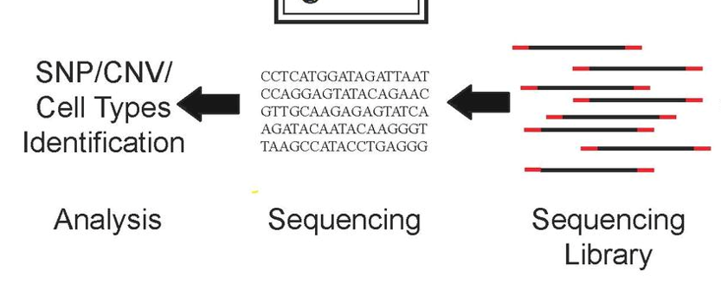
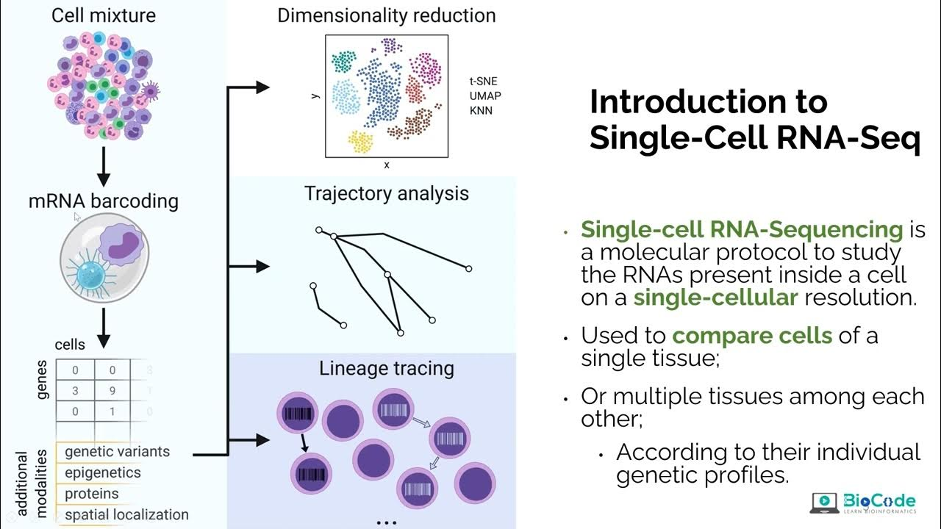
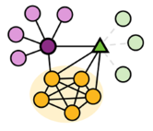
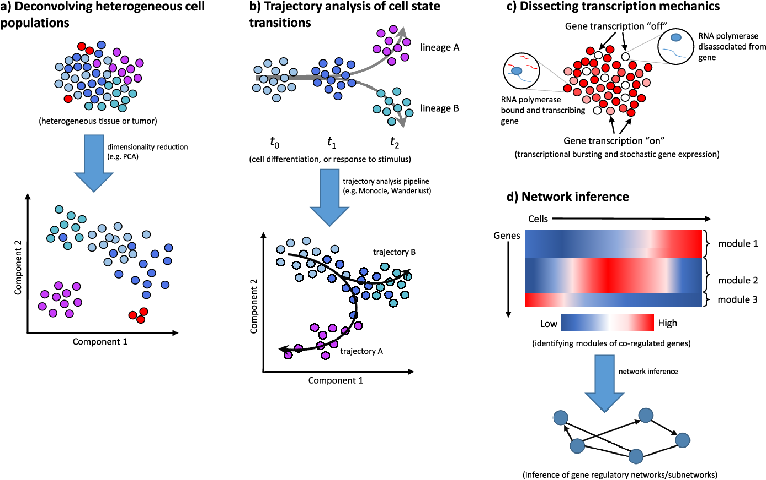
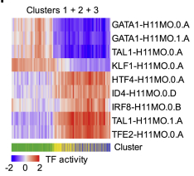
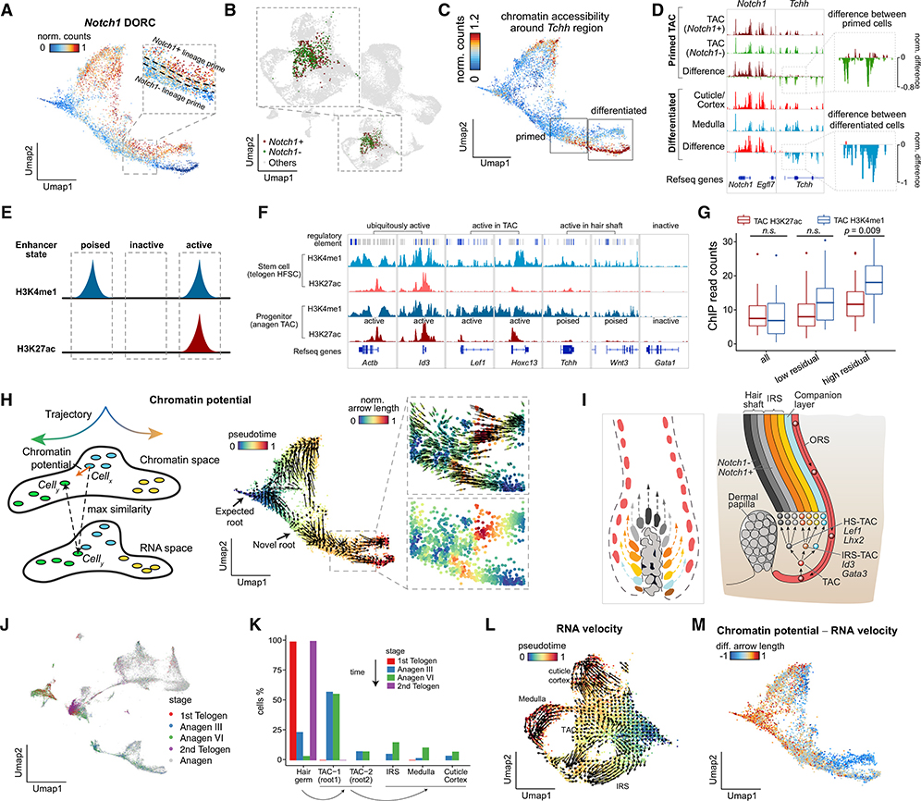
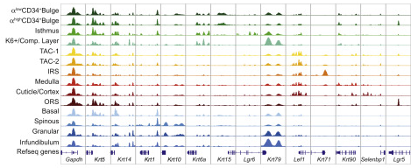
Shaked S. et al., 2021. Luecken MD et al., 2019. Cheng C. et al., 2023. https://holab-hku.github.io/Fundamental-scRNA/background.html
MDA
Sequencing
preprocessing
Serena Liu et al., 2016, Junha Cha., 2020
Trajectory analysis and lineage tracing
Dimensionality reduction
GRN
Regulons
Sai Ma et al., 2020
Label transfer
Regulatory motifs
Chromatin accessibility
scATAC-seq tracks (marker accessibility)
Chromatin potential

Slide 3
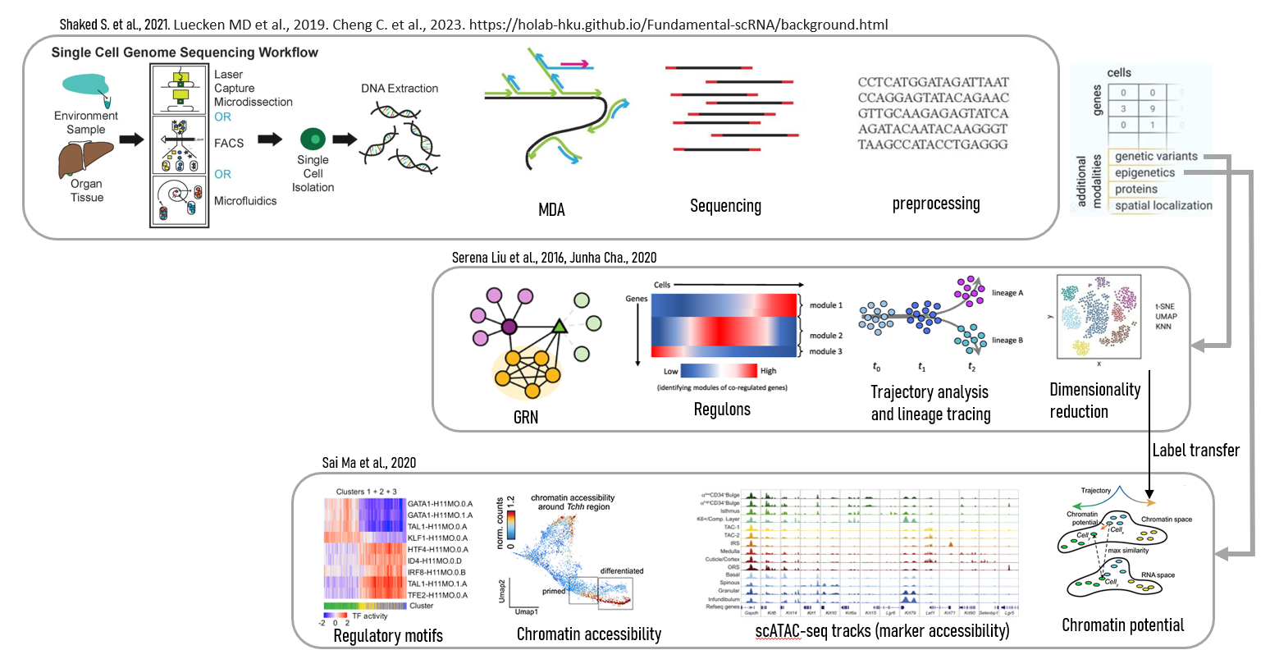


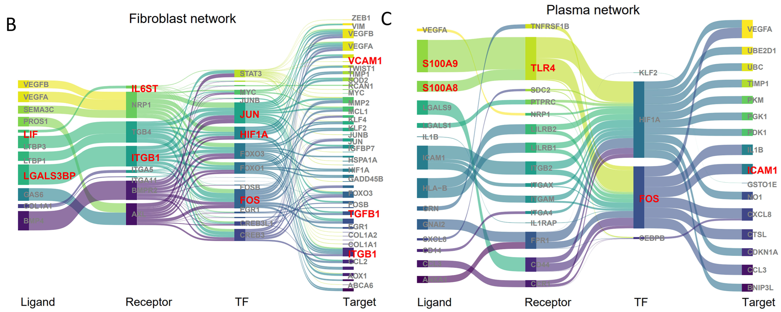
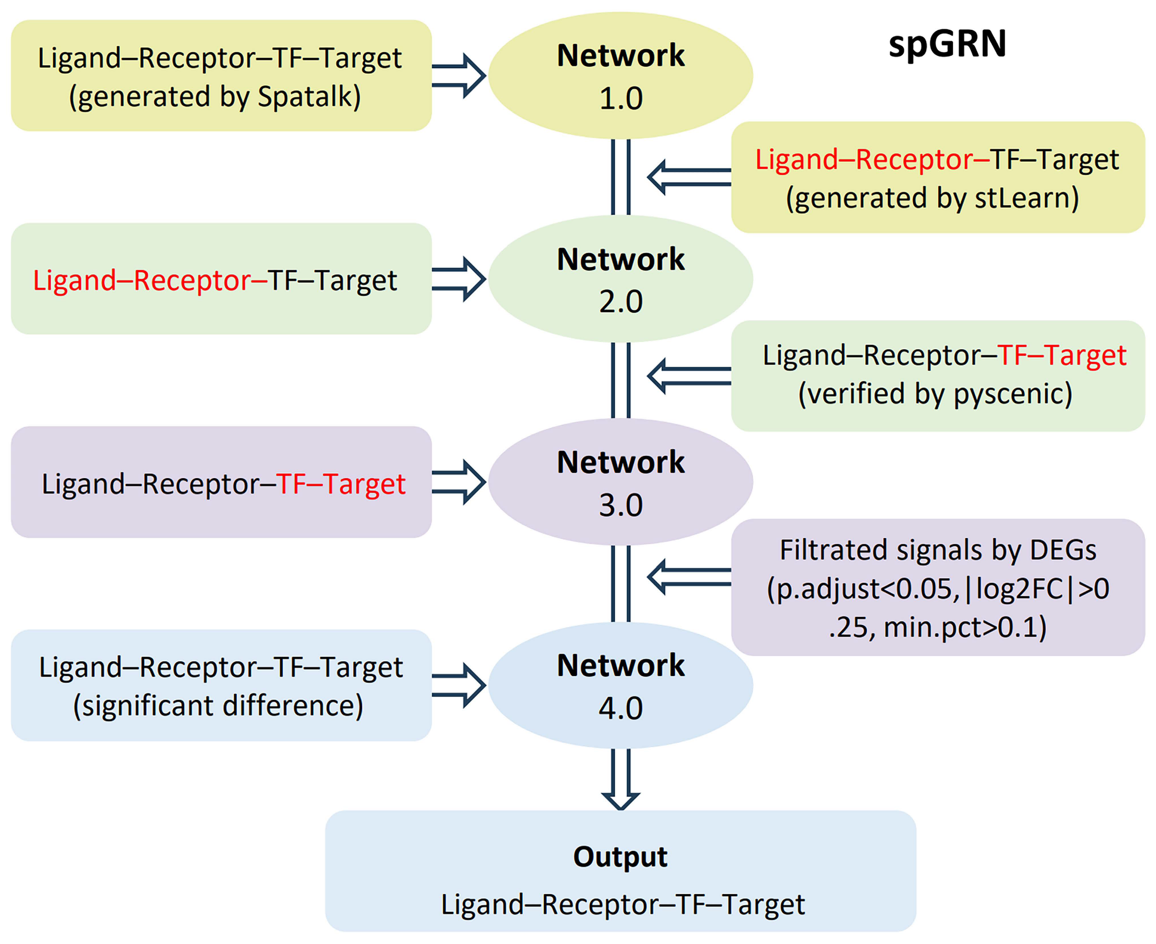
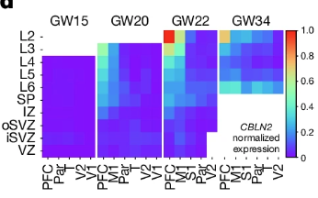
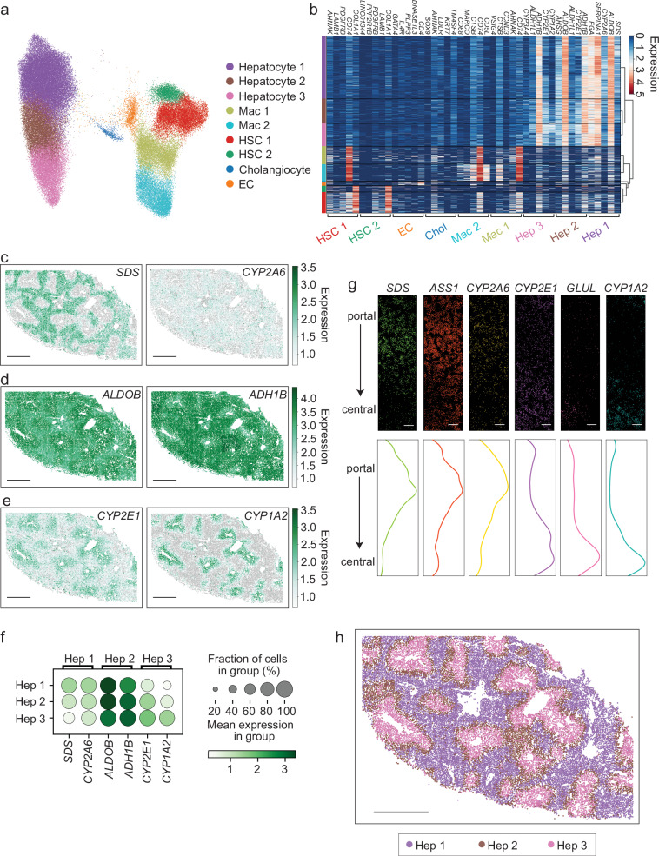
Shaked S. et al., 2021. Luecken MD et al., 2019. Cheng C. et al., 2023. https://holab-hku.github.io/Fundamental-scRNA/background.html
Library preparation
Library preparation
scRNA-Seq
scATAC-Seq
Spatial Transcriptomics
scATAC-seq tracks (marker accessibility)
Watson BR et al., 2025, Du Y et al., 2025. Qian X et al., 2025. https://www.10xgenomics.com/analysis-guides/spatial-gex-lit-review
Label transfer
spGRN’s construction
Gene Spatiotemporal expression
Spatial distribution
Dimensionality reduction
spGRN of malignant cells interacting with fibroblasts and plasma cells

Slide 4
Ma, Sai et al. “Chromatin Potential Identified by Shared Single-Cell Profiling of RNA and Chromatin.” Cell vol. 183,4 (2020): 1103-1116.e20. doi:10.1016/j.cell.2020.09.056
Liu, Serena, and Cole Trapnell. “Single-cell transcriptome sequencing: recent advances and remaining challenges.” F1000Research vol. 5 F1000 Faculty Rev-182. 17 Feb. 2016, doi:10.12688/f1000research.7223.1
Cha, Junha, and Insuk Lee. “Single-cell network biology for resolving cellular heterogeneity in human diseases.” Experimental & molecular medicine vol. 52,11 (2020): 1798-1808. doi:10.1038/s12276-020-00528-0
Slovin, Shaked et al. “Single-Cell RNA Sequencing Analysis: A Step-by-Step Overview.” Methods in molecular biology (Clifton, N.J.) vol. 2284 (2021): 343-365. doi:10.1007/978-1-0716-1307-8_19
Luecken, Malte D, and Fabian J Theis. “Current best practices in single-cell RNA-seq analysis: a tutorial.” Molecular systems biology vol. 15,6 e8746. 19 Jun. 2019, doi:10.15252/msb.20188746
Cheng, Changde et al. “A Review of Single-Cell RNA-Seq Annotation, Integration, and Cell-Cell Communication.” Cells vol. 12,15 1970. 30 Jul. 2023, doi:10.3390/cells12151970
https://holab-hku.github.io/Fundamental-scRNA/background.html
Du, Yiwen et al. “Construction of Gene Regulatory Networks Based on Spatial Multi-Omics Data and Application in Tumor-Boundary Analysis.” Genes vol. 16,7 821. 13 Jul. 2025, doi:10.3390/genes16070821
Watson, Brianna R et al. “Spatial transcriptomics of healthy and fibrotic human liver at single-cell resolution.” Nature communications vol. 16,1 319. 2 Jan. 2025, doi:10.1038/s41467-024-55325-4
https://www.10xgenomics.com/analysis-guides/spatial-gex-lit-review
Qian, Xuyu et al. “Spatial transcriptomics reveals human cortical layer and area specification.” Nature vol. 644,8075 (2025): 153-163. doi:10.1038/s41586-025-09010-1

